Slide 1
Developing A Brief Media Literacy Intervention Targeting Adolescent Alcohol Use: The Impact of Formative Research
Kathryn Greene, Rutgers University
Elvira Elek, RTI International
Kate Magsamen-Conrad, Rutgers University
Smita C. Banerjee, Memorial Sloan-Kettering Cancer Center
Michael Hecht, Pennsylvania State University
Itzhak Yanovitzky, Rutgers University
Funded by NIDA R21DA027146

Slide 2
Introduction
Alcohol is the most widely used substance among America’s youth, higher than tobacco or illicit drugs
Underage drinking leads to a variety of physical, emotional, and social consequences
Imperative to create interventions to prevent alcohol use

Slide 3
Media Literacy (ML) Interventions
New and promising avenue for prevention
  ML expands traditional literacy and uses literacy tools to analyze media
  ML training includes analysis and production (or planning) components
ML training/interventions addressing alcohol
  Overall favorable results (i.e., reduction in alcohol-specific beliefs, attitudes, and intentions) for elemen. and middle school kids
  Can improve cognitive resistance to alcohol ads

Slide 4
Critiques of ML Interventions
Lack of clarity about the causal process
  No explanations of why and how the participants change attitude and/or behavior when exposed to these programs
Failure to form students’ motivation
  ML interventions generally fail to form students’ motivation to resist such influences (focus on knowledge or skill acquisition)
Unclear optimal dosage and length of expected effects
Rarely tailored
  Missing adequate tailoring to the cognitive capabilities and developmental stage of the target audience

Slide 5
Present Study: Curriculum
Grounded in theories of persuasion and information processing; designed to test hypotheses about the process of cognitive change
Produce evidence that involving adolescents actively in generating messages provides a more powerful strategy of using ML in prevention
Feasibility of a brief ML intervention (limited resources)
Develop a ML intervention that is mindful of the unique cognitive experiences of high-school students and test its efficacy against that of a standard media literacy approach
Planning versus analysis conditions

Slide 6
Structure of Curriculum (+ examples, discussion)
Introduction
Target audience, persuasion techniques (4 main ones), claims
Activity 1: Analyze alcohol ad in group
Counter-arguing or missing from ads, anti-ads
Attention, production techniques
Activity 2: Planning anti-alcohol poster
Conclusion (and evaluation)

Slide 7

Curriculum Ad to Generate Discussion

Slide 8
Phase 1 – Pilot of preliminary curriculum: Students
Method
149 10th grade high school students (ages 14-16; M = 15.57, SD = .61)
32 schools across Pennsylvania attending Leadership Institute
Results
The pilot poster planning students viewed the intervention as more novel (t(146) = -2.92, p < .001) and more involving (t(146) = -2.23, p < .01).
Perceptions of novelty and involvement were significantly correlated with perceived gain (novelty r = .18, involvement r = .41; p < .001), reflectiveness (novelty r = .24, involvement r = .47; p < .001), alcohol use intentions (involvement r = -.15, p < .01), and alcohol expectancies (involvement r = -.16, p < .01).

Slide 9
Phase 2: Pilot of preliminary curriculum: Mentors
Method
Mentors accompany students (N = 40; ages 20 to 65, M = 37.38, SD = 13.05) also evaluated the curriculum.
Teachers (64%), counselors (14.5%), administrators (6.5%), youth agency workers (4%), or other (11%), .
Results
Mentors reported planning was more involving (t(38) = -3.48, p < .001), enjoyable (t(38) = -2.57, p < .01), interesting (t(38) = -3.24, p < .001), less boring (t(38) = -3.39, p < .001), more likely to work well in their school (t(38) = -2.81, p < .001), different from the regular classes (t(38) = -1.91, p < .05); perceived structure would facilitate curriculum adoption (t(37) = -1.75, p < .05).

Slide 10
Phase 2: Open-ended Feedback
Pilot feedback also indicated a need to provide more balance in the presentation of pro- and anti-alcohol ads, revise the timing of the lesson, and modify some of the language used.
Mentors recommended that two ads in the activities section be eliminated (of nearly 50 ads), and we found replacement ads.
Mentors recommended that some of the main curriculum ads (n = 9) be changed to non-alcohol ads (all activity ads are alcohol based), and about half of them were replaced with non-beer advertisements (e.g., Coke, Chevy) to better balance the curriculum.

Slide 11
Phase 3: Mentor interviews
Method
  Six months later, six teachers/mentors working with the target population participated in in-depth telephone interviews regarding the curriculum and student participation.
Results
  Identified how to best integrate the curriculum with the program setting and procedural issues related to timing and completion of online surveys.
  Feedback on students’ internet, incentives, and controls
  Details about types of students who attend target program

Slide 12
Phase 4: Student interviews: Measurement
Method
20 interviews with adolescents focused on wording changes to the measurement instruments, specific stimulus advertisements, and refinements to measure instructions.
Results
Provided a test of new measures, including "self-efficacy to counter-argue", "advertising skepticism", and "ad analysis skill based measure".

Slide 13
Phase 5: Student and teacher focus groups: Curriculum
Method: four focus groups
10th grade students (2; 6 female students, 8 male students, mix ethnicity)
Teachers (2; group 1 = 7 teachers, group 2 = 6 teachers; both groups mix gender and ethnicity, ranging in age from late 20 to mid 50.
Results
Specific ads to incorporate (e.g., Pdiddy)
Activity Sheets to improve involvement
Clarify curriculum procedures (and repetition)
Described fits with state curriculum standards and current courses

Slide 14
Discussion
Multi-phase nature
Multi-method approach
Main intervention ongoing (April 2011), recently collected T2
T3 in September

Slide 15
Future Research
Media literacy
Brief interventions
Ensuring that interventions can be utilized by community partners
Future questions such as planning versus production

Slide 16
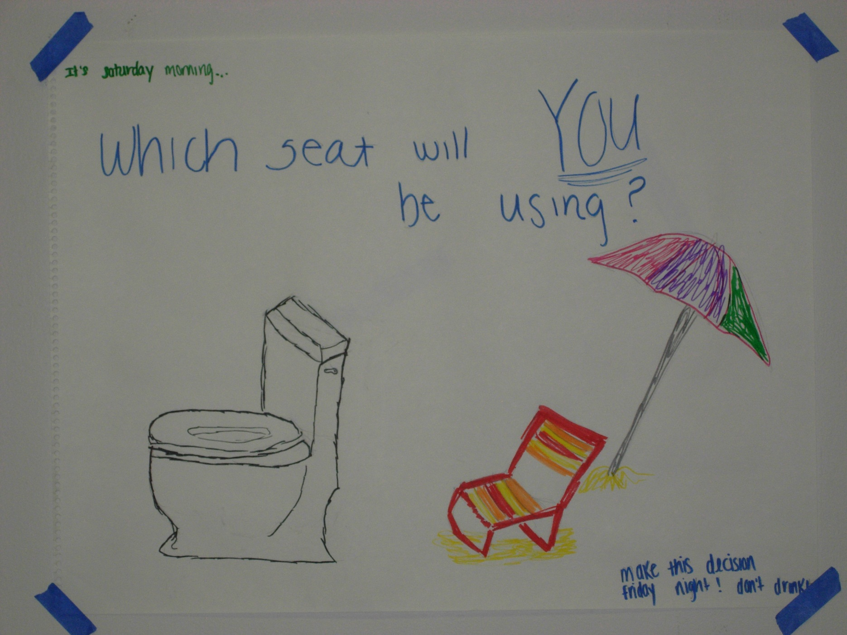

Slide 17
Questions?
Contact
  klgreene@rutgers.edu

